Slide 1
Project # 13: Secondary Car Market
Team Members:
Hanna Khan
Salma Malik
Lisa Xu
Muhammad Abbas Sheikh
August 26th 2021

Slide 2
Objectives
The secondary car market, also known as the used car market, is growing.
The major problem of this market is properly valuing/listing used cars.
To build a Machine Learning Model which will best predict the listing price of secondary cars.
Determine which are the most important factors that drive the listing price of secondary cars.
We are building a predictive model to predict listing price
of used cars.
Notes:
Mention: Carfax, carmax, autocheck have built models for fair valuation.
Steps after building the model: Writing a function which can monitor and
identify listings which are sold and, sell at or close to their
listing price if we rescrape the data everyday.

Slide 3
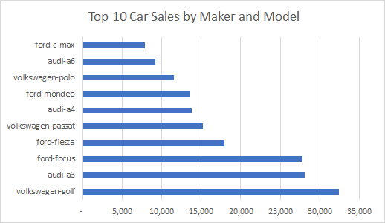
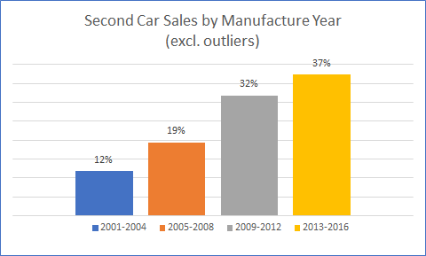
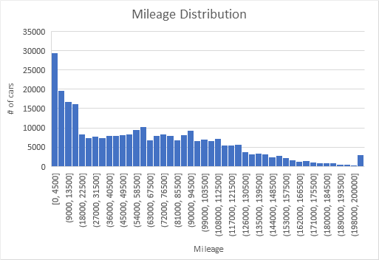
Data Overview
maker
chr, 3 levels
Only 3 levels
Equal number of models in data set
Does not give much information
model
chr, 105 levels
Bar Graph of model sold at the highest price
mileage
num, 67879, levels
highly right skewed
Unreasonable high outlier - 6 million; 2nd largest 199,054
13945/300000=5% cars with <=100 miles.
1763 cars with 0 mileage
manufacture year
chr, 123 levels
unreasonable low outliers
2001-2016 Car Sales vs. Manufacture Year positively correlated.
The newer the more sales.
Notes:
Max of mileage looks too high 6,213,709 when mean is 63,739 and median is 55,914. and a modern vehicle can travel up to 200,000 miles.
2001-2016 Car Sales vs. Manufacture Year positively correlated. The newer the more sales.

Slide 4
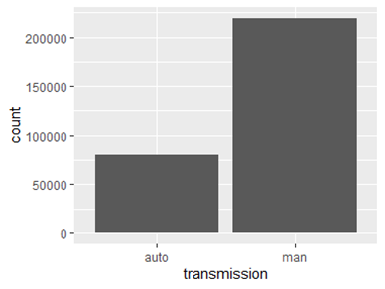
Data Overview
transmission
chr, 2 levels
Only 2 levels
Because this data set is heavy with European cars there is a lot more automatic transmission than there may be in the American car market
door count
chr, 15 unique values, some float and some are int
“None” in Data set missing values (6,149)
Outliers, Max? BOXPLOT
seat count
chr, 33 unique values
“None” in Data set missing values (10,526)
High outliers for seat count 18, 57, 74, 55 (not possible for our car models)
Notes:
highly euro data set. door count and seat count have some major issues. There are a lot of missing values and there are also 0’s. In addition there are very high outliers. It was more difficult to get this data because the “none” had to be replaced with “NA” in order to be recognized as missing data. None is in the data and this is now showing up as missing data. Changed to NA and can see there are 16,675 missing values and 298325 complete values.2 % is 6,149 in door count and 4% 10,526 in seat count.Using sweetviz and changing door and seat to numeric we find important door count and seat count are to price. They are correlated .5 and door count has a stronger correlation to price but it is still a weak correlation .04.

Slide 5
Data Overview
displacement
Normally stated in cubic inches, cubic centimeters, or liters (average is 2L domain knowledge)
Unreasonable low and high outliers (see boxplot)
numeric, 8 levels
horse power
numeric, 9 levels
Most strongly correlated to price
price
num, highly right skewed
Unreasonable high outlier - 6 million; 2nd largest 199,054
13945/300000=5% cars with <=100 miles.
1763 cars with 0 mileage
Notes:
* 2001-2016 Car Sales vs. Manufacture Year positively correlated. The newer the more sales.
Displacement = the total volume of air/fuel mixture an engine can draw in during 1 complete engine cycle;
( normally stated in cubic inches, cubic centimeters, or liters), the greater the engine displacement the more room for more cylinders which could be higher horsepower except for in sportscars when more powerful but smaller cylinders are used.
The average modern day displacement is 2.0 liters. The maximum displacement does not seem realistic. The minimum displacement also does not seem to make sense.
The horsepower of the average American car is between 170 and 190, the minimum and the mean are too low. The maximum is way too high.

Slide 6
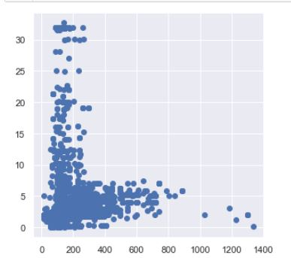
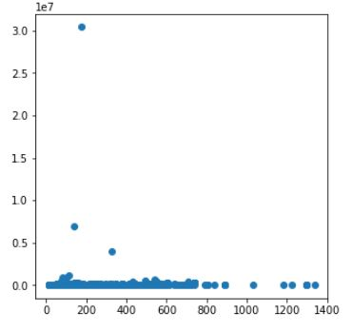
Strongest Correlation to Price and Strongest Correlation between 2 features
Displacement
price
horsepower
horsepower
Notes:
It is important to note that horsepower although has the strongest correlation to price , the correlation is not very strong it is .16 .
Displacement and horsepower have a stronger correlation to each other .54. Since horsepower is the variable that has the strongest correlation to price, we may consider dropped displacement in future analyses.

Slide 7
Salient Observations from Our Data Analysis Journey
Looking back at our Descriptive Questions:
What is the min/max/average mileage of secondary cars?
Min= 0, Max= >6million, Mean = 16,605
What is the min/max/average listing price of secondary cars?
Min price = 0, Max price = 30 million Mean = 13,455
Which are the most important factors that determine the price listing of a secondary car?
Horsepower(.16), displacement(.06), manufacture year(.04), then mileage (-.08)
We cannot be sure that this answer is correct due to the large amount
of issues with our data set including outliers, missing data and mixed
data types.
Notes:
We cannot be sure that this answer is correct due to the large amount
of issues with our data set including outliers, missing data and mixed
data types.

Slide 8
Salient Observations from Our Data Analysis Journey
Looking back at our Predictive Questions:
What is the likelihood that a secondary car with a higher horsepower will have a higher listing price?
While we cannot yet answer the likelihood with a percentage, we know that horsepower is the most correlated factor we have when it comes to price prediction.
What is the likelihood that a secondary car with a low odometer reading will be listed above the average list price?
Again we cannot provide a probability yet however,
we know that mileage was not a strong predictor of price.
Notes:
We cannot be sure that this answer is correct due to the large amount
of issues with our data set including outliers, missing data and mixed
data types.

Slide 9

Driving Onward
Improve ROI
Create ML Model
Test/Fit ML Model
We have been given a Target Variable (Price) which is continuous/numeric. Therefore, we will use a supervised regression model.
Repeat Data Analysis
Address Data Problems
Notes:
From this EDA we can see that our data set has many issues to solve. Here you can see our new roadmap to success! We need to address our data problems, repeat our data analysis. Create a ML model, test/fit our model and then apply what we have learned to improve our ability to predict list price of secondary cars and increase ROI.

Slide 10
Appendix
5 Number Summary
Some statistics on seat and door count
Boxplots showing outliers
Distributions

Slide 11
5 Number Summary
Displacement
Manufacture Year
Mileage
Min | 0.0
1st Quartile | 1.5
Median | 1.8
Mean | 1.9
3rd Quartile | 1.9
Max | 32.7
Min | 39
1st Quartile | 2006
Median | 2011
Mean | 2009
3rd Quartile | 2014
Max | 2017
Min | 0
1st Quartile | 15,992
Median | 55,914
Mean | 16,605
3rd Quartile | 96,934
Max | 6,213,709
Horsepower
Price
Min | 13
1st Quartile | 101
Median | 123
Mean | 136
3rd Quartile | 154
Max | 1337
Min | 0
1st Quartile | 4,797
Median | 16,605
Mean | 13,455
3rd Quartile | 23,271
Max | 30 million
Notes:
There are clearly outliers in Engine displacement, manufacture year, mileage horsepower between 180 and 200, some larger cars have 300 and, price. Price has a standard deviation that is very large(ask the business expert).

Slide 12
5 Number Summary
Door
Seat Count
Min | 1
Median | 8
Mean | 7.97
Max | 15
Min | 1
Mode | 5
Max | 74
Many None values changed to NA, statistical summary provided but it would be better to clean the data before running these statistics. Able to change to numeric for statistical analysis and found the results above.
Notes:
There are also some very high numbers for seat count (18, 57, 74, 55) out project is not a used aircraft market analysis and there are no cars which fit that many people.

Slide 13
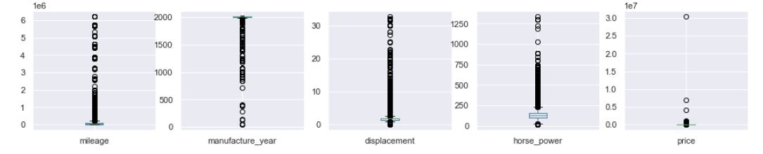
Outliers with Boxplots

Slide 14
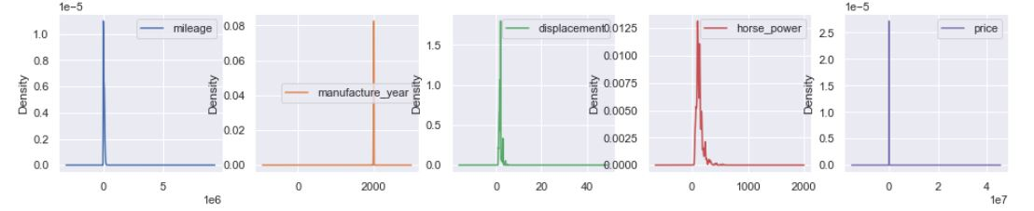
Density/Distribution
Notes:
Some variables are very skewed meaning the majority of the data is not close to the numbers of center (mean, median, mode). It should be between -1 and 1
Mileage 34.74
Transmission -1.05
Seat count 2.27
Displacement 16.65
Horse power 2.52
Price 449.20
Some variables kurtosis is all over the place. Kurtosis should be between -2 and 2.
Mileage 1992.56
Transmission 5669.70
Displacement 7
Horse power 12.66
Price 226674,89
This means the majority of the data is in the tails and we do now have a bell curve in our data set when graphed.

Slide 15
Secondary Car Market
Presentation 3
Hanna Khan
Lisa Xu
Salma Malik
Abbas Sheikh
Data Transformations and Selected ML Models

Slide 16
Solutions to implement resolve problems
reduce cardinality/dimensionality
fix skewness
deal with missing values
take care of outliers
What modeling techniques? Why did we chose these?
how did we get data ready for modeling?
in appendix include codes or graphs we want to share

Slide 17
Data Transformations
Model and Maker
Model Nominal variable, high level of cardinality, Maker can be encoded into dummy (binary), equal numbers of each maker in the set
Problems and Solution
Group by maker and aggregate by price for the, 103 level models category
Result
Simplified and less noisy data, this reduces dimensionality.

Slide 18
Data Transformations
Mileage
Displacement had many outliers, they were removed using the IQR
Problems and Solution
Capping was considered however, we decided to just remove the outliers.
Result
Now more normal distribution

Slide 19
Data Transformations
Manufacture Year
Displacement had many outliers,
Problems and Solution
Filtered using judgement from the business, cars realistically last 20 years so we are going back 20 years from 2017.
A new variable car_life was created by subtracting the model year from the year 2017
Result
More easily understood and relevant data set

Slide 20
Data Transformations
Transmission
Transmission is categorical with 2 values manual and automatic. Also this data set is heavy with manual consider making 2 training sets for ML?
Problems and Solution
We use encoding to create binary dummy variables for transmission and drop one column. Consider scaling.
Result
Binary values will work well in a ML model. Scaled features good for Naive Bayes.

Slide 21
Data Transformations
Door count and Seat Count
Door and seat count had missing values between 2 and 5% so these were removed from the data set.
Problems and Solution
Door count’s correlation to the TV is .006 so we are dropping this variable.
Result
There are outliers in seat count as well. We are considering, imputing them, capping outliers or removing them each would result in a more normal distribution

Slide 22
Data Transformations
Displacement and Horsepower
Displacement had many outliers, they were removed using the IQR. Displacement and horsepower are correlated to each other by .5
Problems and Solution
Outliers identified and removed using IQR statistics
Result
Now more normal distribution

Slide 23
Data Transformations
Target Variable Price
The distribution of price may be skewed but for sales data it can still be correct.
Problems and Solution
Feature scaling improves convergence of algorithms
We are avoiding a situation where some data overpowers other
No other transformations on Price!
The price variable will not be touched unless it is unbalanced or it is continuous and not normally distributed.

Slide 24
Data Transformations
Duplicates
Problems and Solution
We found about 10% duplicates which we removed.
Duplicates are noise in our dataset.

Slide 25
Secondary Car Market
Analytical Approach
Salma Malik, Hanna Khan, Lisa Xu, Abbas Sheikh
Notes:
300,000 rows. 10 columns (features), , 5 Numeric, 3 categorical, 2 Mixed data
type Variables, All variables are skewed except Maker.
•Column names are properly formatted.
•After reading the data, we see no missing values, however we have missing
Values as none in the CSV file Seat count and Door count.
All features should be Numeric Except Maker, Model & Transmission
We have float and objects in our data type.
Numerical features are not normally distributed.
Displacement and horsepower are somewhat correlated.
t

Slide 26
Recap - Objectives
The secondary car market, also known as the used car market, is growing.
The major problem of this market is properly valuing/listing used cars.
To build a Machine Learning Model which will best predict the listing price of secondary cars.
Determine which are the most important factors that drive the listing price of secondary cars.
We are building a predictive model to predict listing price
of used cars.
Notes:
Mention: Carfax, carmax, autocheck have built models for fair valuation.
Steps after building the model: Writing a function which can monitor and
identify listings which are sold and, sell at or close to their
listing price if we rescrape the data everyday.

Slide 27
Recap - Data Quality
The raw data has many issues:
Many outliers
Missing values
Unrealistic values
Skewness
Duplicate records

Slide 28
Assumptions of the Multiple Linear Regression Model
Linearity
Scatter plots show non-linear relationship;
the log function improved linearity.
Homoscedasticity
Homoscedasticity is met checked using Durbin Watson must be less than 4, we got 2 (as seen in OLS)
Independence
Prior to running our models we dropped the most highly correlated variables and created more independent data. However after running OLS we find there is still some multicollinearity.
Normality
We had high skewness which we improved using IQR and p values to remove outliers.
We were also able to visualize.

Slide 29
ML Model Selection
For a continuous TV prediction, we identified the following Models:
Multiple Linear Regression
OlS Regression (stat model)
Random Forest
Ridge Regression
Lasso Regression
ElasticNet
K-Nearest Neighbor
Decision Tree Regression
XGboost
Notes:
MLR - Multiple X’s and 1 Y (TV)
Random Forest - Ensembled DT Model which a bunch of DT together.
Ridge, Lasso and ElasticNet are Regularization Models.
OLS - Ordinary Least Square model (stat model)

Slide 30
Next Steps
So far decision tree performed the best. We have only x variables and each is statistically significant to the TV.
Based on R^2 results, the models are not performing as good as we would like them to. So we will be making further transformations on our data.(e.g.further reduce Homoscedasticity.)
We logged price and explored other transformations
on our features. We dropped highly correlated
values after transformations as well.

Slide 31
Recommendations
December 19th, 2021
Notes:
300,000 rows. 10 columns (features), , 5 Numeric, 3 categorical, 2 Mixed data
type Variables, All variables are skewed except Maker.
•Column names are properly formatted.
•After reading the data, we see no missing values, however we have missing
Values as none in the CSV file Seat count and Door count.
All features should be Numeric Except Maker, Model & Transmission
We have float and objects in our data type.
Numerical features are not normally distributed.
Displacement and horsepower are somewhat correlated.
t

Slide 32
ML Model Selection
For a continuous TV prediction, we identified the following Models:
Multiple Linear Regression
OlS Regression (stat model)
Random Forest
Ridge Regression
Lasso Regression
ElasticNet
K-Nearest Neighbor
Decision Tree Regression
XGboost
Support Vector Regression
Notes:
MLR - Multiple X’s and 1 Y (TV)
Random Forest - Ensembled DT Model which a bunch of DT together.
Ridge, Lasso and ElasticNet are Regularization Models.
OLS - Ordinary Least Square model (stat model)

Slide 33
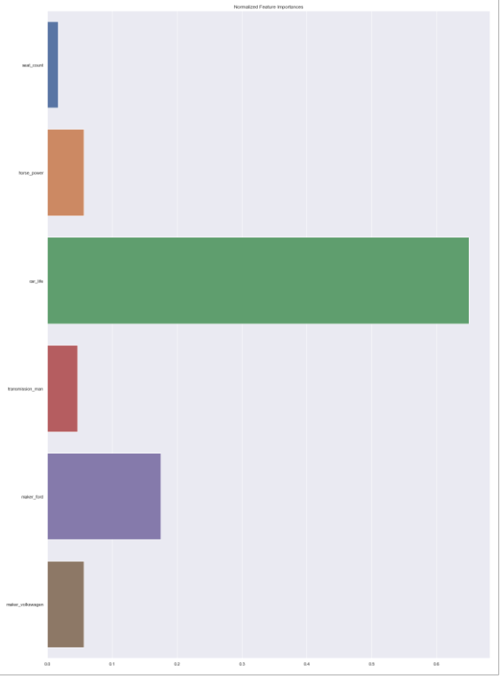
Feature Importance
Car Life
Horse power
Notes:
from XG boost

Slide 34
ML Model Selection
Random Forest
Powerful, Accurate, works with non linear also
Can be overfitting(not so generalizable), difficult to interpret
R2 = .68
Multiple Linear Regression
Accurate / Precise understanding of association of each factor with outcome (price)
Ability to ID outliers
Disadvantages: incomplete data, causation is not equal to correlation
Small sample
R2 = .66

Slide 35
Recommendation/Action Plan
We recommend Random Forest or Multiple linear Regression Models as R Squared is 68% and 66% respectively. Also, MSE is 36%, however the RMSE is higher.
66% of the data points are living close to the best fit line. The model represents a model that explains 66% variation in the response variable around its mean, it explains 66% of the variation in our dependent variable which is price.
Action plan: Look into more car features that could have an impact on the predicted price of the car so that more accurate models can be built. Get more data that is representative of the American car market(we need more automatic cars).
Notes:
It’s a business decision if they want to accept only 66%

Slide 36
Appendix
Comparison of R2
R2, RMSE and MSE
Residuals for MLR
Distributions

Slide 37
Model Results
Model | R^2 (Co-efficient of Determination)
Base Model | -3.456173476523716e-06
Multiple Linear Regression | 0.67
Decision Tree Regression | 0.78
XGRegressor | .59
Random Forest Regression | 0.68
Ridge Regression | 0.57
Lasso Regression | 0.07
Elastic Net | 0.59
KNN Regression | 0.62
Ordinary Least Square Model | .60
Notes:
Baseline Model A baseline regression model will give us something to compare our other models to. In sklearn, the default result of the .score method is the coefficient of determination (r² or R²). This number explains the percent of variation of the input data that the Baseline Model | 193 prediction captures. The value is typically between 0 and 1, but it can be negative in the case of particulary bad models. The default strategy of the DummyRegressor is to predict the mean value of the training set. We can see that this model does not perform very well:

Slide 38
Model Results
Model | R^2 | RMSE | MSE
Base Model | -3.46e-06
Multiple Linear Regression | 0.66 | 0.60 | 0.36
Decision Tree Regression | 0.66 | 0.60 | 0.36
XGRegressor | 0.59?
Random Forest Regression | 0.68 | 0.60 | 0.36
Ridge Regression (K Fold) | 0.66 | 0.60 | 0.36
Lasso Regression | 0.65 | 0.61 | 0.61
Elastic Net | 0.57 | 0.61 | 0.61
KNN Regression | 0.66 | 0.60 | 0.36
Ordinary Least Square Model | 0.66 | 0.36 | 26936?
Linear SVR | 1.00 | 2.18e-24 | 4.3e-24
Notes:
Baseline Model A baseline regression model will give us something to compare our other models to. In sklearn, the default result of the .score method is the coefficient of determination (r² or R²). This number explains the percent of variation of the input data that the Baseline Model | 193 prediction captures. The value is typically between 0 and 1, but it can be negative in the case of particulary bad models. The default strategy of the DummyRegressor is to predict the mean value of the training set. We can see that this model does not perform very well:

Slide 39
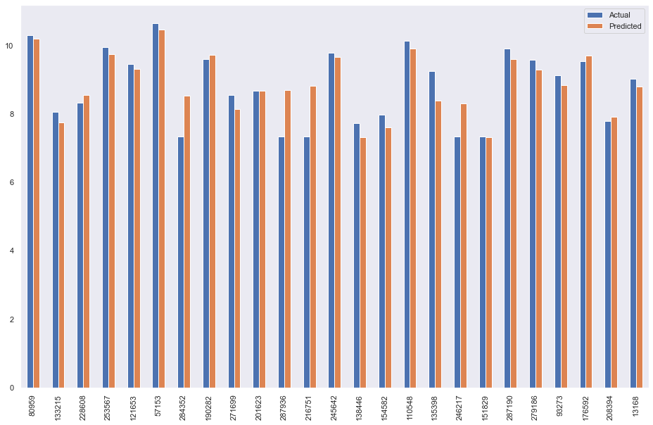
Residuals for Multiple Linear Regression

Slide 40
Feature Importance
Car Life
Maker
Horse power
Transmission
Notes:
from XG boost

Slide 41
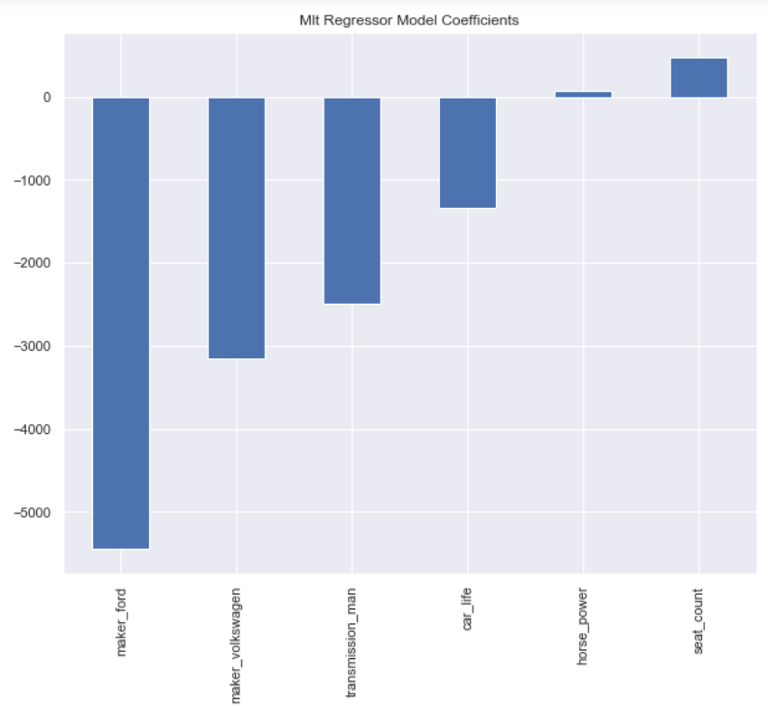
ML Regression Models Coefficients

Slide 42
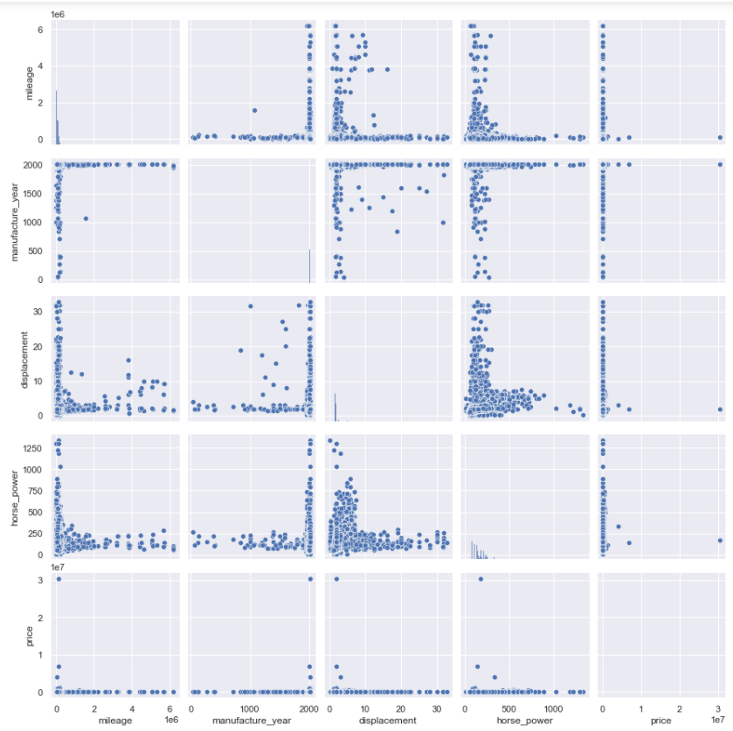
Pair Plot - relationship between Xs and Y before transformation

Slide 43
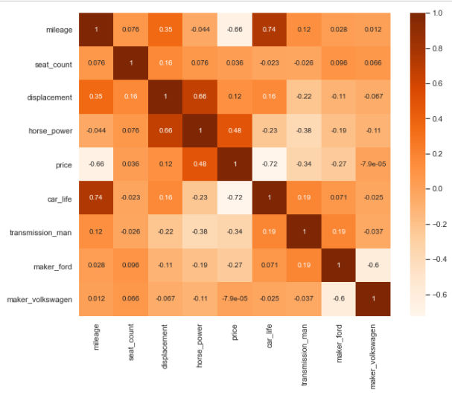
Heat Map showing Multicollinearity

Slide 44
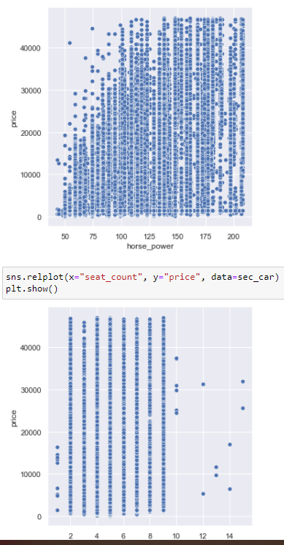
Relationship between X and Y before Transformation

Slide 45
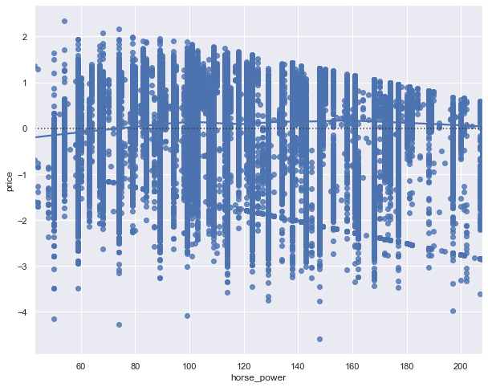
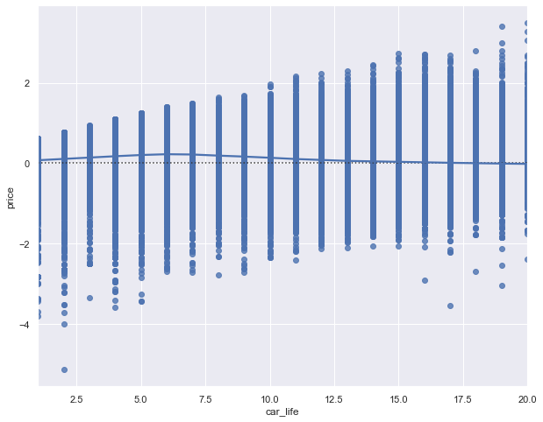
Residuals
Horsepower to price
Car life to price

